Slide 1
REVIEW — 1 | ACADEMIC YEAR 2026–27
Design and Implementation of a Database Management System for Courier Parcel Booking and Tracking Management System
Dara Keerthana
Roll No: 25WU0102125
B.Tech AI & ML (Panthers), Woxsen University
DBMS

Slide 2
02 • COURIER DBMS
Introduction
Courier companies process high parcel volumes every day. Manual records create errors, delays, and inconsistent updates across branches. A centralized DBMS connects bookings, tracking, routes, deliveries, charges, and payments.
Customer
Booking
Parcel
Branch / Hub
PARCEL LIFECYCLE
Booking → Tracking → Delivery → Payment
Route
Tracking
Delivery
Payment
02

Slide 3
03 • COURIER DBMS
Problem Statement
Inaccurate parcel tracking
PROPOSED SOLUTION
Duplicate or missing records
One relational database.
One reliable parcel record.
Charge and payment errors
No central movement history
Centralize customers, parcels, bookings, tracking events, charges, and payments—while enforcing consistent rules across every branch and hub.
Delays are hard to identify
Reporting is time-consuming
Inconsistent branch / hub data
03

Slide 4
04 • COURIER DBMS
Objectives
01
02
03
Centralize courier operations
Maintain customer & parcel data
Issue unique tracking numbers
04
05
06
Track movement end-to-end
Manage hubs, routes & resources
Record delivery attempts
07
08
09
Calculate courier charges
Maintain payment records
Generate management reports
04

Slide 5
05 • COURIER DBMS
Scope of the System
Customer Management
Registration • booking history
Parcel Management
Booking • tracking number • weight / dimensions • status
Courier Operations
Branches / hubs • routes • vehicles • delivery agents
Tracking & Delivery
Scan events • route movement • updates • failed attempts
Financial Management
Charge calculation • payments • revenue reports
05

Slide 6
06 • COURIER DBMS
Users & Functional Requirements
Customer
Branch Staff
Delivery Agent
Admin / Manager
Database Administrator
Book • track • view payment
Book • scan • update movement
Deliver • record attempts
Manage network • reporting
Security • maintenance
FUNCTIONAL CORE
Customer registration • Parcel booking • Charge calculation • Tracking and scanning • Route movement • Agent assignment • Delivery updates • Failed-delivery handling • Payment management • Report generation
06

Slide 7
07 • COURIER DBMS
Major Entities
Customer
Branch
Hub
Service Type
Parcel
Booking
Route
Scan Event
Vehicle
Delivery Agent
Delivery Attempt
Charge
Payment
07

Slide 8
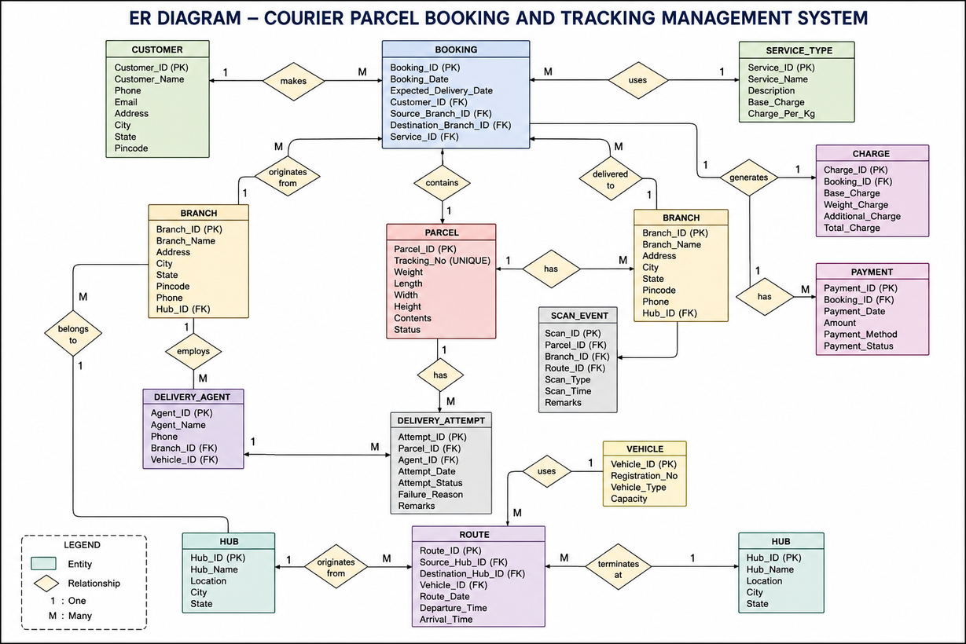
08 • COURIER DBMS
Entity–Relationship Diagram
Entity-Relationship Diagram of Courier Parcel Booking and Tracking System
08

Slide 9
09 • COURIER DBMS
Initial Relational Schema
CUSTOMER
BRANCH
HUB
SERVICE_TYPE
PARCEL
Customer_ID PK
Name • Phone • Email
Address • City • State • Pincode
Branch_ID PK
Name • Address • City • State
Pincode • Phone • Hub_ID FK
Hub_ID PK
Name • Location
City • State
Service_ID PK
Name • Description
Base_Charge • Charge_Per_Kg
Parcel_ID PK
Tracking_No UNIQUE
Weight • Dimensions • Contents • Status
OTHER TABLES
Booking • Route • Scan_Event • Vehicle • Delivery_Agent • Delivery_Attempt • Charge • Payment
PK = Primary Key FK = Foreign Key
09

Slide 10
10 • COURIER DBMS
Business Rules & Future Work
BUSINESS RULES
FUTURE WORK
Unique tracking number per parcel
Normalize from 1NF to 3NF
Parcel weight must be greater than zero
Complete data dictionary, DDL, and constraints
Charges positive; payments cannot exceed charges
Load sample data; build SQL queries and views
Delivered parcels accept no further scans
Generate operational and management reports
Scan events follow a valid status sequence
Develop Python / Java application connectivity
Attempts reference a valid parcel and agent
All foreign keys preserve referential integrity
Implement booking, pricing, tracking, scanning, assignment, updates, and testing
10

Slide 11
Thank You
Q&A
Questions & Suggestions?

